Slide 1
VIVID SOLUTIONS & SERVICES
Doing More with Every Agent
How intelligent automation lightens the contact-centre workload —
so human agents handle less busywork and deliver more value.
AI Operations Platform · CRM · Contact Centre · Sales 22 June 2026

Slide 2
THE CHALLENGE
Call-centre teams are drowning in repetitive work
Every call still starts the same way — greeting, identifying the caller, working out what they need, then manually logging and routing it. That is time agents do not spend actually helping customers.
70%
Long
Missed
of an agent’s time goes on triage, data entry and routing — not resolution
queues build while callers repeat their details to multiple people
SLAs and lost sales leads when hand-offs fall through the cracks
The opportunity: remove the busywork, and the same team can handle more — and handle it better.
Vivid Solutions & Services
2

Slide 3
THE SOLUTION
One platform that takes the load off agents
🤖
🧭
⏱️
📈
AI voice agent
Smart routing
SLA on autopilot
Sales captured
“Nadia” greets every caller, understands the need and logs it automatically.
Tickets reach the right team instantly, by predefined rules — no manual sorting.
Turnaround timers, reminders and escalations run themselves before any breach.
Promising enquiries convert to pipeline deals in one click — nothing slips.
The result: agents stop sorting and typing, and start resolving and selling.
Vivid Solutions & Services
3

Slide 4
HOW IT WORKS · 1 OF 3
From call to the right team — automatically
📞 Customer
calls in
🤖 Voice bot “Nadia”
greets & listens
🧠 Understands the
customer’s requirement
▶
▶
▼
Bot creates the right record
📝 Complaint
ticket
🎧 Support
ticket
💼 Sales
ticket
▼
▼
▼
🧭 Smart routing → sent to the relevant team by predefined criteria
(skills, queue, capacity)
No agent has lifted a finger yet — the call is greeted, understood, logged and routed on its own.
Vivid Solutions & Services
4

Slide 5
HOW IT WORKS · 2 OF 3
The ticket runs to a deadline — and never lets it slip
STEP 1
STEP 2
STEP 3
STEP 4
STEP 5
✅
⏳
🔔
⚠️
🎉
▶
▶
▶
▶
Agent accepts
In progress
Interval alerts
Auto-escalate
Resolved
TAT / SLA clock starts
Worked through stages & milestones
Reminders at set checkpoints
Before the deadline is breached
Customer informed + CSAT survey
Turnaround promise, kept automatically. The timer, the reminders and the escalation all run by themselves — agents are nudged in time, managers see breaches coming, and the customer is told the moment it’s done.
Vivid Solutions & Services
5

Slide 6
HOW IT WORKS · 3 OF 3
Spotted a real opportunity? It flows straight to sales
💼 Sales ticket
accepted by agent
🔎 Agent sees genuine
potential in the enquiry
🔁 One click:
“Convert to Deal”
▶
▶
▼
📈 Deal enters the sales pipeline — owned, valued and forecastable
New
▶
Qualified
▶
Proposal
▶
Won
Nothing is lost between “support call” and “sales opportunity” — the hand-off is instant and tracked.
Vivid Solutions & Services
6

Slide 7
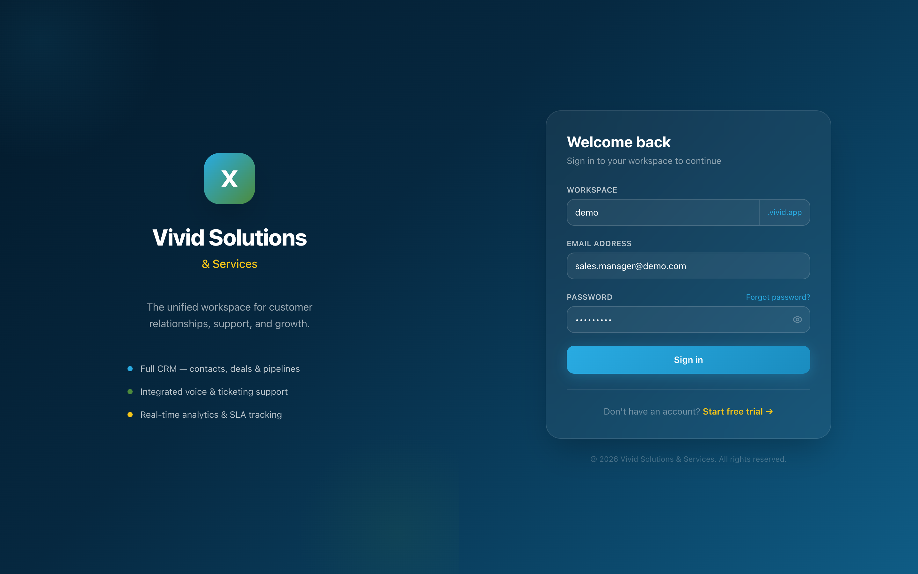
INSIDE THE PLATFORM
Secure, multi-tenant sign-in
One front door
Each customer organisation gets its own isolated, secure workspace
Branded login per workspace
Role decides exactly what each person sees once inside
Vivid Solutions & Services
7

Slide 8
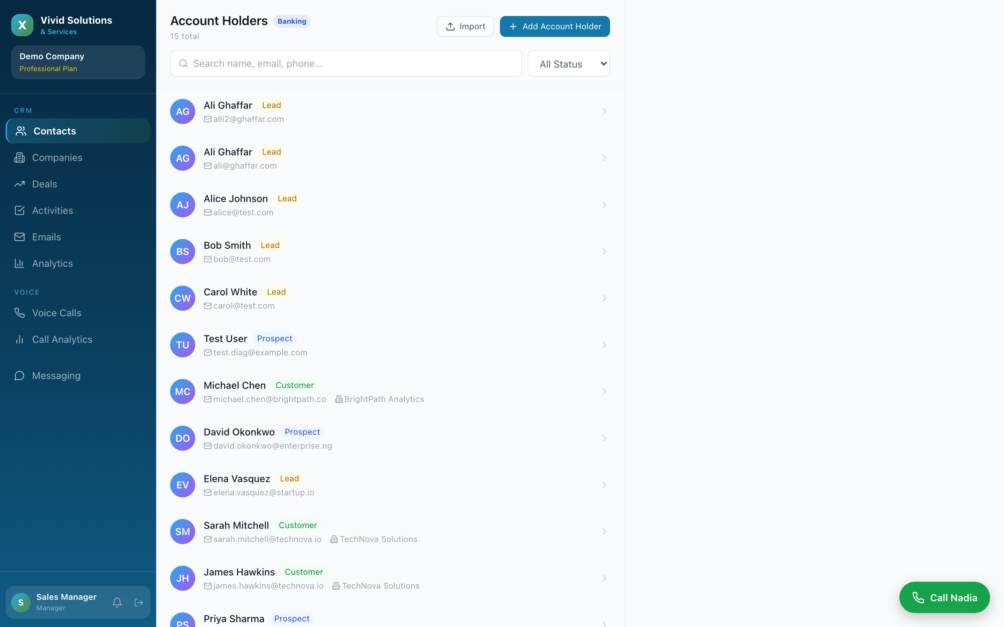
INSIDE THE PLATFORM
One unified customer record
Every caller, in context
Contacts (here “Account Holders”) with status & source at a glance
Search and filter instantly
Tickets, deals and history tied to the same person
Vivid Solutions & Services
8

Slide 9
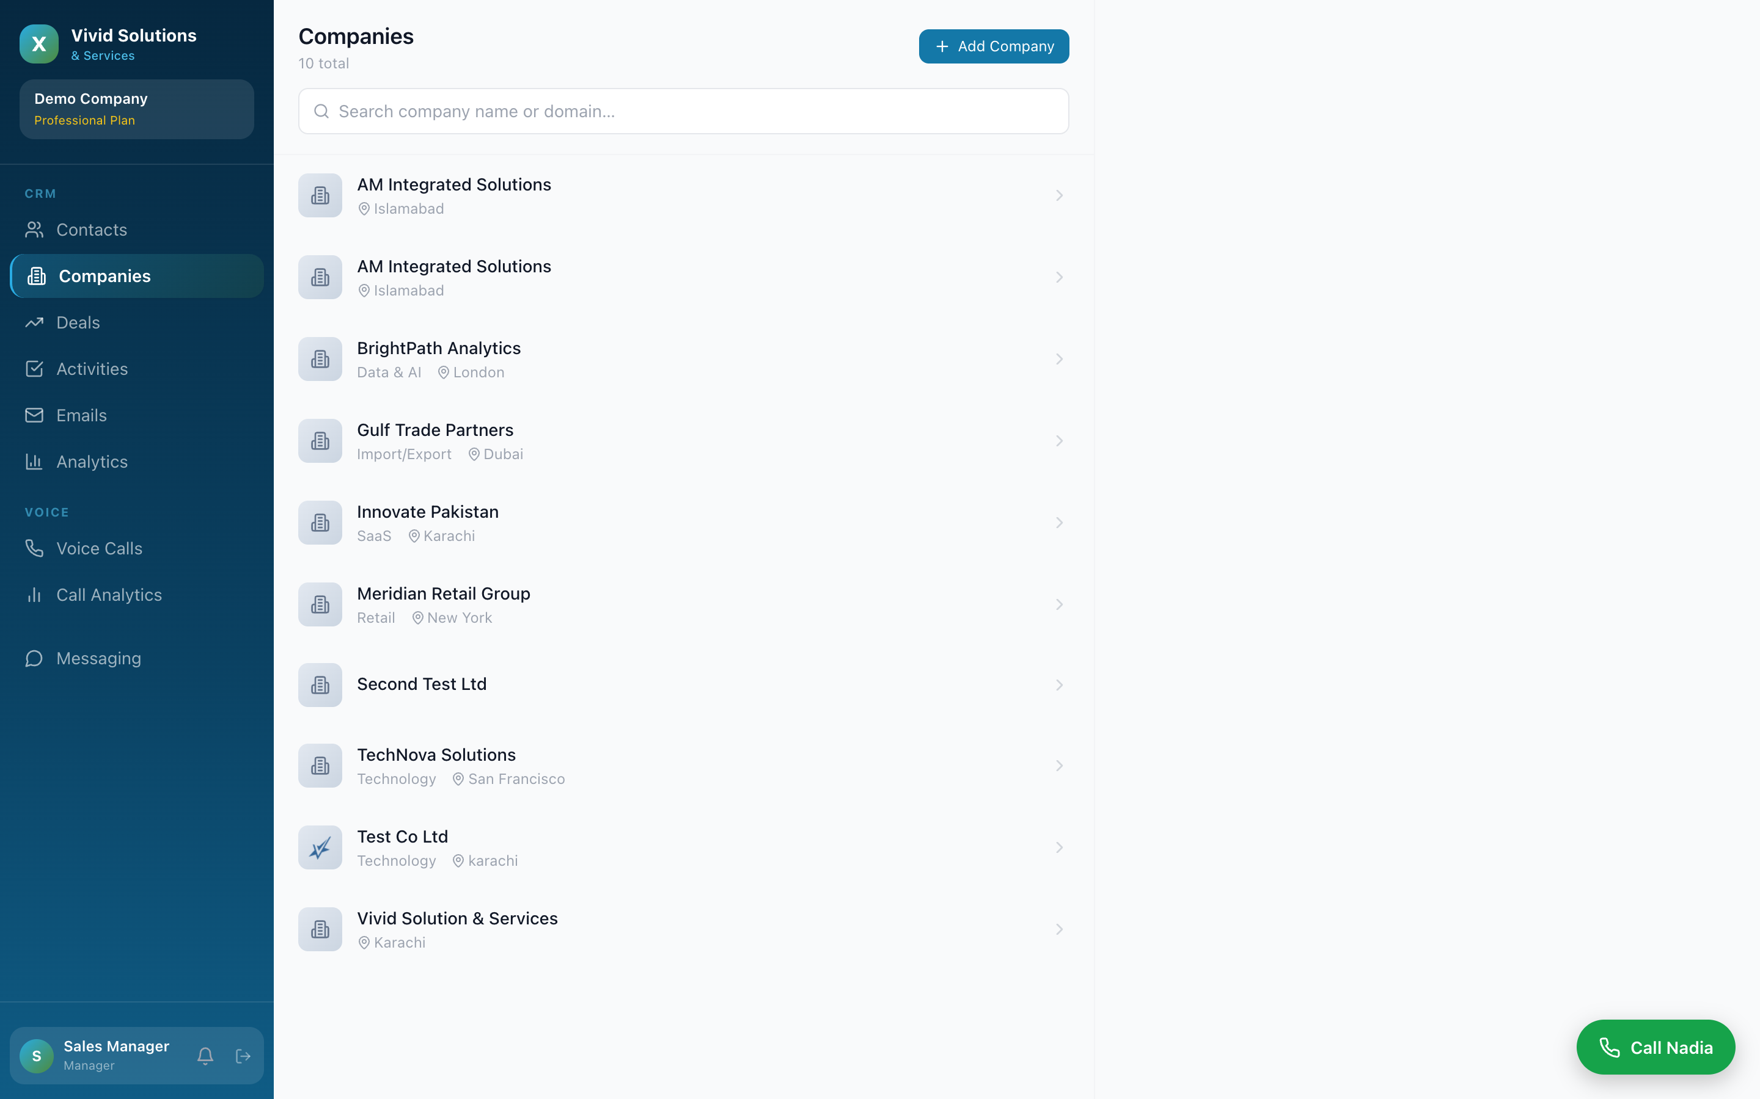
INSIDE THE PLATFORM
Companies & accounts
The bigger picture
Organisations linked to their people and deals
Sector-aware fields
A complete relationship view, not scattered spreadsheets
Vivid Solutions & Services
9

Slide 10
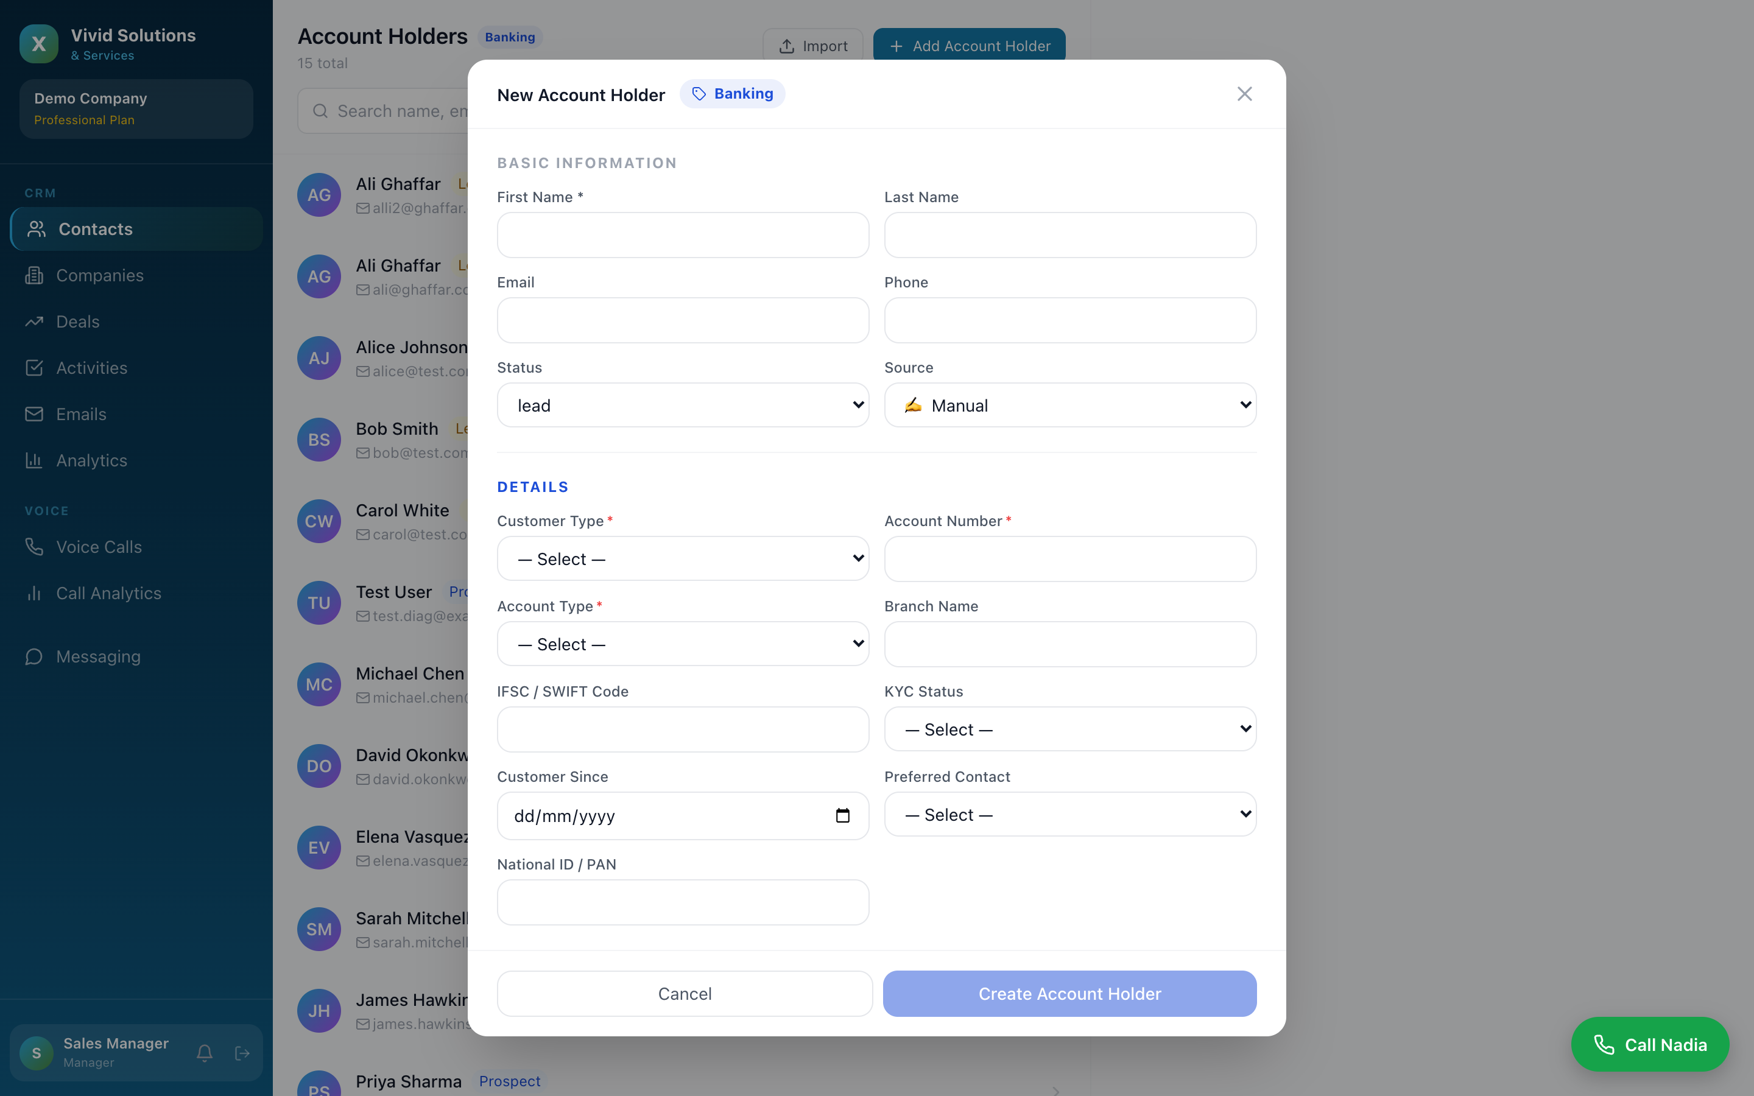
INSIDE THE PLATFORM
Fast, guided data capture
Capture once, cleanly
Sector-specific form (banking shown) with the right fields
Required fields enforce data quality
What the bot captures lands here automatically
Vivid Solutions & Services
10

Slide 11
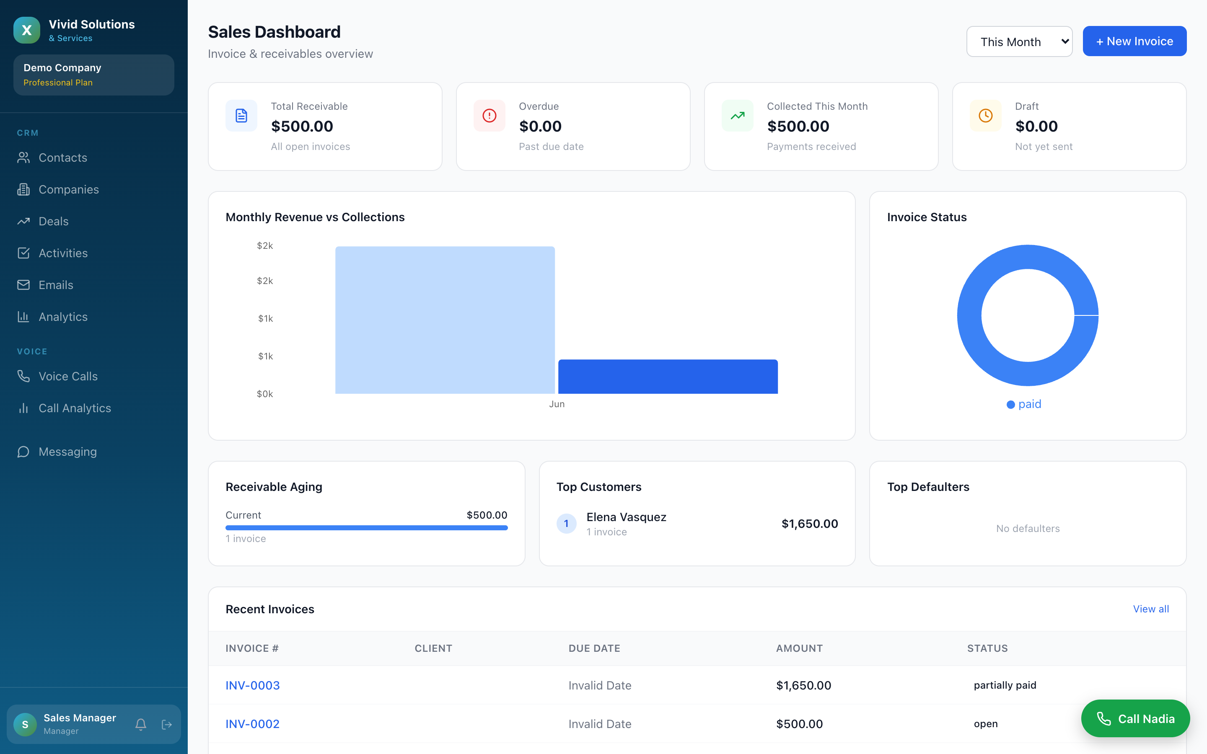
INSIDE THE PLATFORM
Sales visibility for managers
Revenue at a glance
Receivables, collections and invoice status live
Top customers and ageing surfaced automatically
Each manager sees only their own team’s numbers
Vivid Solutions & Services
11

Slide 12
THE PAYOFF
Less busywork. More delivered.
Agents focus on people
Faster, kept promises
Greeting, triage, logging and routing are automated — agents spend their time resolving and selling.
SLA timers, reminders and escalations run themselves, so deadlines are met without manual chasing.
No lost opportunities
Same team, more output
Sales enquiries convert to pipeline deals instantly — and managers see exactly what’s in play.
Removing the repetitive load lets the existing team handle more volume, with better quality.
Automation does the repetitive work — your people do the work that matters.

Slide 13
Built to let every agent deliver more.
AI Operations Platform · CRM · Contact Centre · Sales
Vivid Solutions & Services

